Slide 1
What Do We Know When We Know A Person? Madeline G. Twenty Years On
Mark H. Waugh, Ph.D., ABPP
Appalachian Psychoanalytic Society
March 6 and 13, 2021
Knoxville, Tennessee

Slide 2
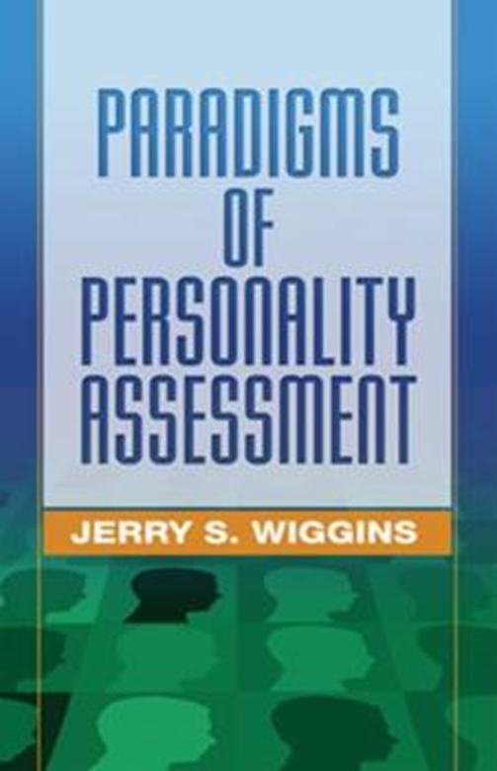
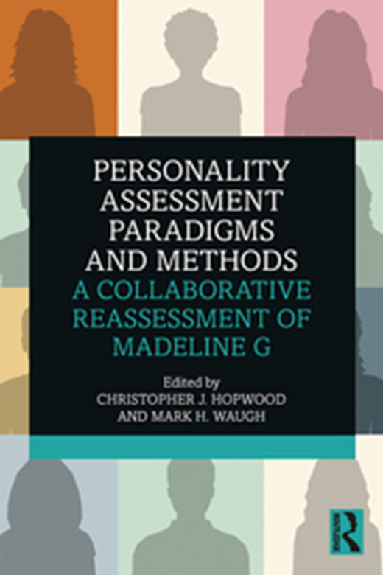
Madeline G Twenty Years On: March 6
Part I
How did this come to be?
Context & Frame
Knowing a Person, Mentalizing
Video Clip 1
Paradigms & Pluralism
Epistemic Petrification
Sources of Data: interview, observation, psychological tests, counter-transference experience
Madeline 1.0 (Wiggins, 2003)
MMPI-2, Circumplex, NEO-PI-R, Rorschach, TAT, ORI
Intro: Madeline 2.0 (Hopwood & Waugh, 2019)
[brief intro] Therapeutic Assessment (TA) & video Steve Finn

Slide 3
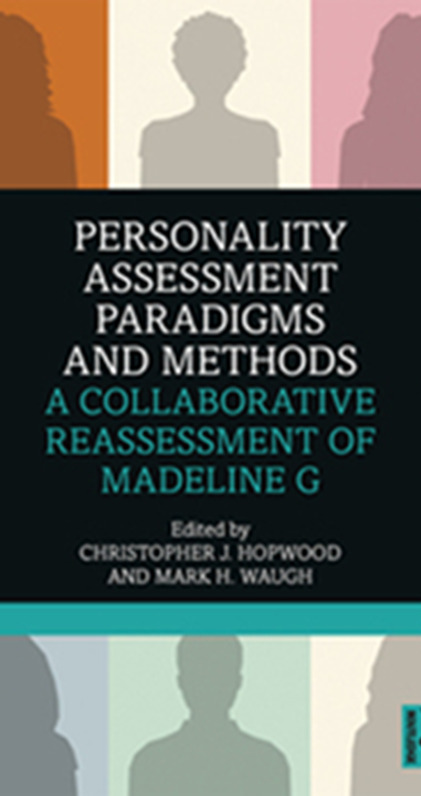
Objectives: this seminar will provide a basis to:
Describe similarities and differences of different paradigms of personality assessment.
State personality features that were stable and those that changed over time in this 20-year longitudinal case history.
Identify key aspects of the therapeutic assessment frame for appraising persons.
Recognize common expressions of the core idiographic “stamp” of a person evident via different assessment instruments including the instrument of intersubjectivity, experience, and narrative modes of appraisals.

Slide 4
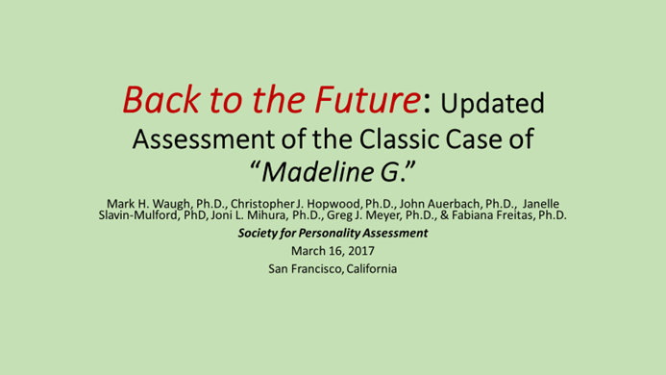
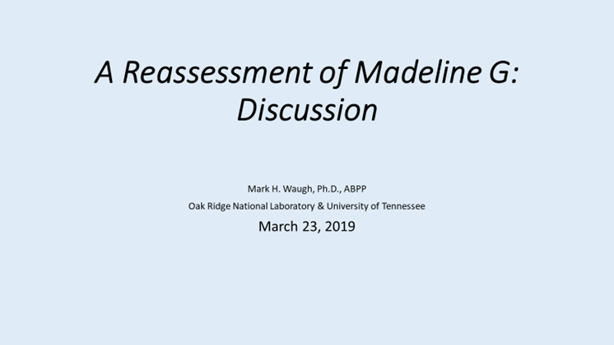
How did this project come to be?
Can the Wiggins (2003; from 1999) data be updated?
Psychodynamc chapter raw data available
MMPI-2; new scales, including PD Spectra scales? Data lost…
Numerous conversations with Krista Trobst
Attempts to locate original Rorschach protocol, Blatt Estate, nil
SPA 2017 (Hopwood, Meyer, Mihura, Auerbach, Slavin-Mulford, Freitas)
Renew the Project? Who do the paradigms…McAdams to Finn
C/TA 2018
Book deal
SPA 2019: Chris Hopwood, Yossi Ben-Porath, Greg Meyer, Aaron Pincus, Tom Widiger, me (discussant)
Notes:
Discuss origins

Slide 5
McAdams, D. P. (1995). What do we know when we know a person?. Journal of personality, 63(3), 365-396.
One of the great social rituals in the lives of middle-class American families is "the drive home." The ritual comes in many different forms,
but the idealized scene that I am now envisioning involves my wife and me leaving the dinner party sometime around midnight, getting into our car, and, finding nothing worth listening to on the radio, beginning our traditional post-party postmortem.
Summoning up all of the personological wisdom and nuance I can muster at the moment, I may start off with something like, "He was really an ass."
Or adopting the more "relational" mode that psychologists such as Gilligan (1982) insist comes more naturally to women than men, my wife may say something like, "I can't believe they stay married to each other." It's often easier to begin with the cheap shots. As the conversation develops, however, our attributions become more detailed and more interesting.

Slide 6
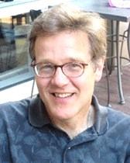
“What do we know when we know a person?” Broad Heuristics
“Actor, Agent, Author” (McAdams, 2015)
Dispositional Traits
Characteristic Adaptations: motives, defenses, core-conflictual relationship themes, developmental level, attachment style—contextualized in time, place, role
Narrative Identity: Self, Identity, Life Story
McAdams (1995): 3 “levels” of constructs: with “indigenous nomenclature, taxonomies, theories, frameworks, laws.” Can include implicit/unconscious domains too.

Slide 7
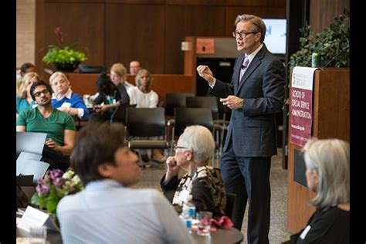
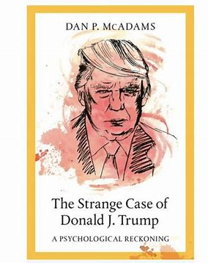
Dan McAdams ‘actor’ ‘agent’ ‘author’ (personological paradigm for Madeline 1.0)

Slide 8
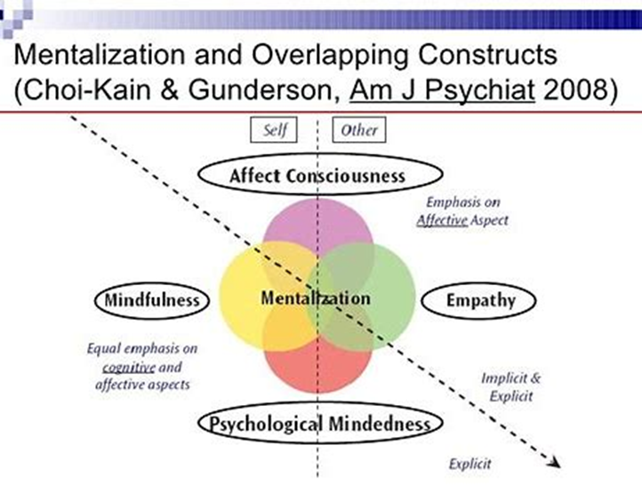
Background Concepts
Mentalizing & Epistemic Trust

Slide 9
Nagel, T. (1974). What is it like to be a bat?. The philosophical review, 83(4), 435-450. cited 10,131 times (Google Scholar, 2/14/2021)

Slide 10
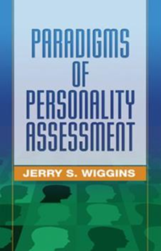
The Book: Widiger, T. A. (2005). Paradigms of Personality Assessment. American Journal of Psychiatry, 162(8), 1558-1559. (Review of Wiggins, 2003)
“assessment of an individual, ‘Madeline,’ by well-recognized experts of each of the five basic paradigms…”
“eminent investigators provide their assessments largely blind to one another, and, if I can speak colloquially, this was a cool idea…”
“…does she have a very colorful personality and intriguing life history, … book also includes a follow-up to her life story years after the original assessments were conducted (the follow-up is provided by Krista Trobst and Jerry Wiggins), which adds an intriguing clinical relevance and predictive validity component…”

Slide 11
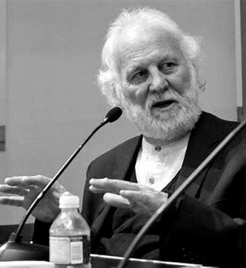
Shadow of Object
What, Where, When, Who is Madeline’s “Shadow (s) of the Object”?
Christopher Bollas (1989)
British Object Relations
“Unthought Known”
Interactions with early caregivers =
Internalized “memories” encoded in body / mind,
These memories not consciously known,
enacted & experienced intersubjectively, more like experience-tone/moods

Slide 12
Mentalization – can the person “read” oneself? Can the person read you? Mentalize the feedback?
Mentalization –
Theory of Mind & Attachment (Bowlby) lead to - Reflective Functioning (Fonagy, Bateman, et al)
Like empathy, psychological mindedness, mindfulness
interpreting actions by inferred mental states (symbolizing)
Implicit, Explicit, Self, Other, Cognitive, Affective, Content, Process

Slide 13
Fonagy, P., Luyten, P., & Allison, E. (2015). Epistemic petrification and the restoration of epistemic trust: A new conceptualization of borderline personality disorder and its psychosocial treatment. Journal of personality disorders, 29(5), 575-609.
Peter Fonagy:
“trust comes from a sense of feeling oneself understood by another mind”
As social animals, evolution has bestowed social learning & attachment processes
child learns from experience with attachment figures
information often signaled by ostensive cues, creating readiness to take in info
Borderline PD (heuristically) is premature hardening/inflexibility of epistemic trust
Self-other schemas rigidify & relatively impervious to constructive social learning (input)
Kamphuis, J. H., & Finn, S. E. (2018). Therapeutic assessment in personality disorders: Toward the restoration of epistemic trust. Journal of personality assessment.

Slide 14
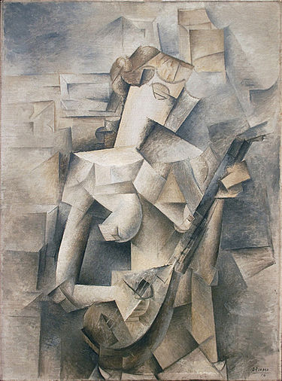
Assumption- Pluralism
Pluralism in philosophy of science (Chang, 2004; 2012)
“Dappled” Universe - multiple concepts & methods (Cartwright, 2011)
Karl Jasper’s (1957/1997) “methodological pluralism”- concept & method
(objective-scientific) + (subjective/interpretive)

Slide 15
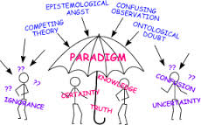
Paradigms: Finding our Way in Knowing a Person; How Persons find Their Way
Theory, Orientation, Training, Our Experience, Paradigm, & “Map”
Persons: What are the interpersonal schema from which interaction and experience is determined?

Slide 16
Nancy McWilliams: “10 Angles of Vision” http://psichoterapija.org/uploads/documents/renginiai/Individuality..pdf
Temperament
Attachment style
Observed Clinical Patterns (e.g., “Neurotic Styles”)
Defensive Organization (A. Freud; Vailliant; Cramer)
Implicit Cognitions (e.g., control-mastery perspective; Beck CBT)
Affective Patterns (Tomkins’ Script Theory; Panksepp’ s Affective Neuroscience)
Drive / Motivational Systems
Individualistic vs Communal Orientation
Internalized Object Relations (Fairbairn); Internal Working Models
Developmental Level of Organization (Kernberg; Fonagy-Reflective Functioning)
Notes:
Note the implied pluralism in this psychodynamic conceptualization

Slide 17
Knowing a Person?
Fundamental “Opacity” of Knowing Another
Context?:
Acquaintance? Friend? Partner/Spouse? Child? Patient? Self?
Why? Purpose of Knowing? – professionally…
description, prediction, DSM diagnosis, treatment planning, Collaborative/Therapeutic Assessment, consultation, medication recommendation, benchmark change, forensic/decision, etc.

Slide 18
Mentalize:
Explicit Mentalize = psychotherapy; receive C/TA feedback
Borderline PD = hypermentalize others (over interpret), hypomentalize self (unclear, shifting self-awareness); fixed at affective mentalizing; automatic, not explicit mentalization
Antisocial PD = Cognitive hypermentalize others, Affective hypomentalize others
Narcissistic PD = Cognitive hypermentalize others, even ability to affectively mentalize others, but weak motivation , fluctuating pattern of empathy… not simply deficiency
Pseudomentalize – lot of words, not much meaning
Madeline Day 1 AM With Mutes.mp4 (dropbox.com)

Slide 19
As we discuss “knowing” Madeline G.-2.0
Winnicott’s (1967/1986)- “antisocial tendency”
no matter how self-defeating / off-putting, acting out is vestige of developmentally frustrated hopes of being understood
Acting out expresses life scripts currently maladaptive-- but not originally so

Slide 20
Influential Case Histories
Psychoanalysis - Freud’s Dora (Ida Bauer), Rat Man (Ernst Lanzer)
Chris Sizemore (Three Faces of Eve, 1957)- Thigpen & Cleckley (1954).
“A Case of Multiple Personality,” J. Abn Psych, 49, 135-151.
Erik Erikson’s (1969) – Gandhi (psychobiography)
And Psychological Assessment has – Madeline G. (Wiggins, 2003)

Slide 21
Collaborative Case Study
“Madeline”
Interviewed by Dan McAdams-Northwestern Univ.
Traveled to Yale, “blind” assessment by Behrends & Blatt
Inventories completed for Interpersonal, Multivariate, Empirical paradigms & supplied to experts who had her history from McAdams

Slide 22
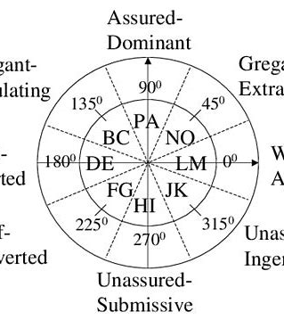
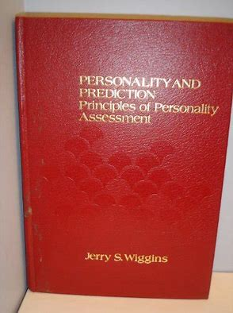
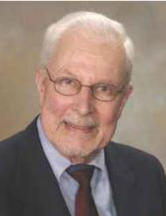
Who was this Wiggins dude?
MMPI: content scales, substantive vs style
Interpersonal Circumplex
Personality & Prediction
Paradigms of…
Wiggins, J. S. (1966). Substantive dimensions of self-report in the MMPI item pool. Psychological Monographs: General and Applied, 80(22), 1.
Wiggins, J. S. (1962). Strategic, method, and stylistic variance in the MMPI. Psychological Bulletin, 59(3), 224.
Wiggins, J. S. (1991). Agency and communion as conceptual coordinates for the understanding and measurement of interpersonal behavior.

Slide 23
Paradigms of Personality Assessment Jerry Wiggins (2003) w./ Behrends, Ben-Porath, Blatt, Costa, Gurtman, McAdams, Piedmont, Pincus, & Trobst
History & development of 5 major traditions in personality assessment that address
“What is personality?”
“How should we measure it?”
“What should we measure?” (p.1)
Borrowed from Thomas Kuhn (1962/2012) The Structure of Scientific Revolutions

Slide 24
Wiggins (2003): 5 Assessment Paradigms
Psychodynamic (Freud; unconscious conflict)
Personological (Henry Murray; life history data)
Interpersonal (Harry S. Sullivan; interpersonal)
Multivariate (Sir Francis Galton; differential psychology; Big-5, FFM)
Empirical (Kraepelin [diagnostic constructs]; MMPI/MMPI-2)*
*Does not mean other paradigms not “empirical”
*Wiggins emphasizes psychiatric diagnoses and empirical keying of MMPI for Empirical Paradigm

Slide 25
Wiggins (2003) - Assessment paradigms have:
Range of convenience & focus
Preferred instruments
Concepts / models of mind
Educational pedigree (“invisible college;” where you trained has big impact)

Slide 26
Tacit metaphors of the 5 paradigms
Psychodynamic – conflict & unknown (Freud’s “iceberg” metaphor—most is not visible)
Interpersonal – “Field Theory” of electromagnetism, interpersonal field
Personological – Life story, narrative
Multivariate – multidimensional space of correlation matrix of trait variables
Empirical – diagnostic syndrome (medical, Kraepelin)

Slide 27
Basic Assumptions of Psychodynamic Approaches to Psychopathology (Luyten et al 2015)
Developmental perspective
Unconscious motivation & intentionality
Transference
Person-oriented perspective
Recognition of complexity
Focus on the inner world and psychological causality
Continuity between normal & disrupted personality development

Slide 28
Psychodynamic Markers Wiggins’ (2003)
Range & Focus:
Intrapsychic with interpersonal “transference template,” behavior multiply determined, character structure (Neurotic Styles, Shapiro [1965])
Instruments:
Test battery (structured to less-structured); Menninger-Yale Battery
Concepts / Models of Mind:
ego psychology, defense mechanisms, level of functioning, anaclitic-introjective, developmental lines, object representations /relations, attachment, “action language” (Schafer, 1976)
Educational Pedigree:
Blatt & Behrends- represent Menninger-Yale tradition of Rapaport, Gill, & Schafer (1946)

Slide 29
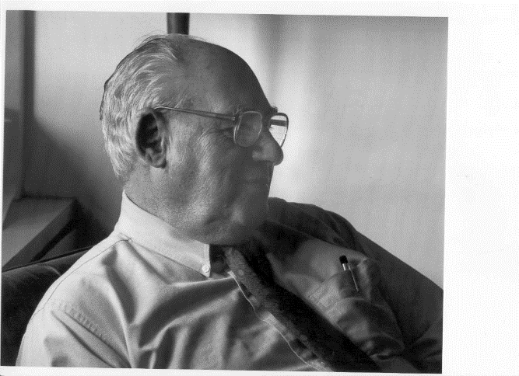
“Madeline” Evaluation: Behrends & Blatt- Stated Assumptions (pp 226-227)
Understanding achieved through --
test scores
content/themes
style of verbalization
interpersonal relationship (including Examiner’s empathic cues)
observed systematically across different levels of organization & structure

Slide 30
What do we know when we know a person? The Menninger-Yale Report Format’s answer:
Introduction, Procedures Administered, Observations
Diagnostic Understanding
Experience of Self & Other
Intellectual Functioning
Action & Thought
Affect & Organization
Treatment Recommendations
Appelbaum, S.A. (1972). A method of reporting psychological test findings.
Bulletin of the Menninger Clinic, Vol 36(5), Sep 1972, 535-545.

Slide 31
Dan McAdams: Personological Paradigm
3-hour interview at Northwestern
Life Story Interview
Key Scenes: High Point, Low Point, Turning Points, Early memories, Adolescent Memory, Adulthood Memory
Greatest Challenges
Greatest Positive and Negative Characteristics
Projection for Future Chapters of Life
Basic Values & Beliefs
Central Theme (“survival”)

Slide 32
History: Dan McAdams
35-­years ­old (in December 1999)
Defense attorney in Albuquerque; earns $70K+
Single, but with partner for about 6 years
A “common-law marriage”
He is a college professor; No children
Native American (Navajo)
On interview, divides life into 3 large chapters
“Childhood,” “Jail,” and “The Present”

Slide 33
3 Early Memories (Dan McAdams’ assessment)
1. Father shot mother
2. Fight in living room by Christmas tree; watching from hole in floor above; mother stabbed father with scissors
“She stabbed him in the throat, and there’s all this… blood spraying across the room, and I remember … my brother looking at me going, ‘Gross …’
3. Mother not home; father mum; in hospital for slitting her wrists
Visited her, priest there, seemed she would die; “I asked her if I could kiss her goodbye and she said, ‘No.’ … That’s how close we were. … So, love? Not a whole lot of love.”

Slide 34
The 1999 “Present”
Around 21, moved, got waitress job, rented apartment
In 20s, married, soon divorced
Relationship was based mainly on “good sex”
Took classes at community college
Tutored older illiterate man, great joy teaching him to read
Teacher encouraged her to apply to a university
Admitted to Ivy League university
Advanced degrees in social work and in law
About undergraduate graduation (1993), 1st met partner
Her “rock” – foundation of support for all she does
Problems obtaining law license but now very successful
Represents Native Americans in civil and criminal cases
Soon (January 2000), new job as defense lawyer with prestigious firm in Albuquerque
35 years old, Native American Woman

Slide 35
Collaborative Assessment of Madeline:
Paradigm | Instruments | Assessors | Affiliations
Psychodynamic | Rorschach, WAIS-III, TAT, Object Relations Inventory | Rebecca S. Behrends & Sidney J. Blatt | Yale U.
Interpersonal | Interpersonal Adjective Scales (IAS); Inventory of Interpersonal Problems-Circumplex (IIP­C) | Aaron L. Pincus & Michael B. Gurtman | Penn State U. & U. of Wisconsin-Parkside
Personological | Life Story Interview; Big Five Inventory (BFI); Loyola Generativity Scale (LGS); Personal Strivings; Satisfaction with Life Scale; research version of TAT | Dan P. McAdams | Northwestern U.
Multivariate | Revised NEO Personality Inventory (NEO PI-­R) | Paul T. Costa, Jr. & Ralph L. Piedmont | National Institute on Aging & Loyola College
Empirical | Minnesota Multiphasic Personality Inventory-2 (MMPI­-2) | Yossef S. Ben­-Porath | Kent State U.

Slide 36
Madeline’s MMPI-2
Madeline’s MMPI-2
(spike 9, moderate 4 & 5)

Slide 37
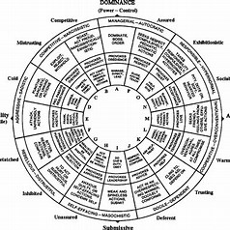
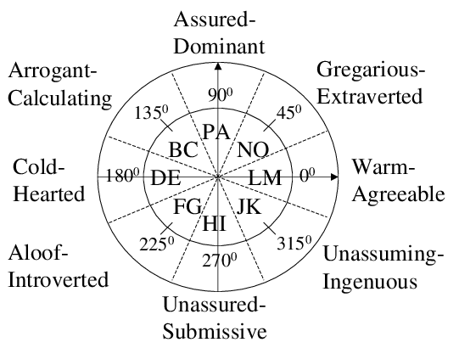
The Interpersonal Circumplex Model of Personality

Slide 38
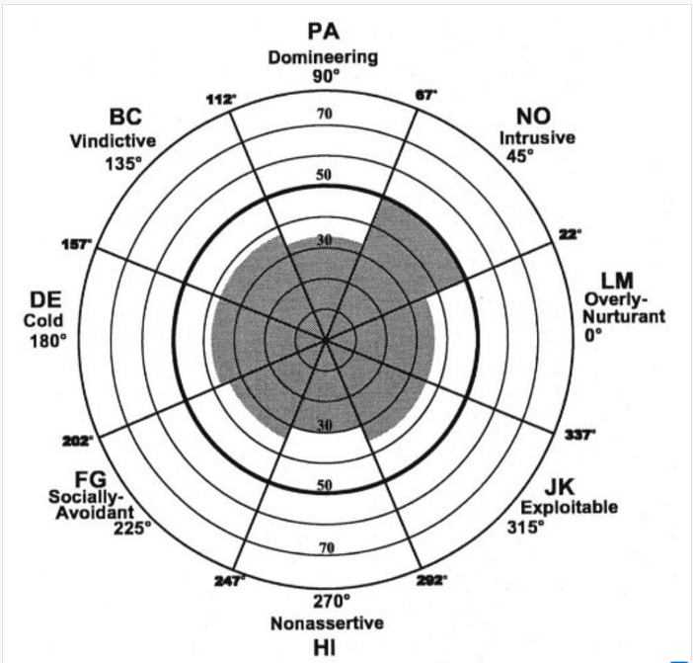
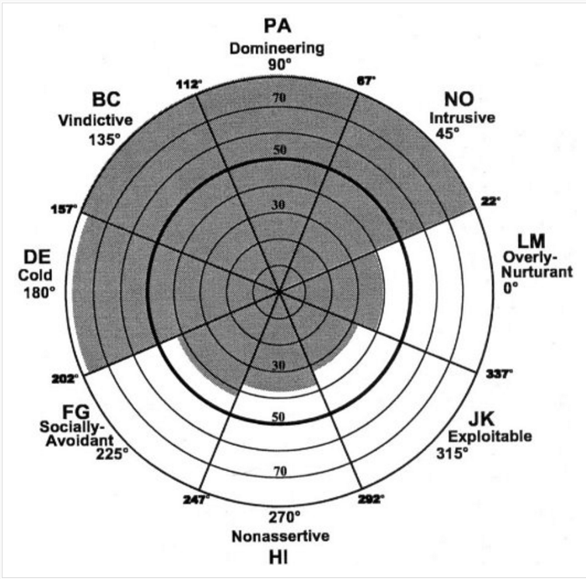
Madeline’s IIP-C: Self (Left) & Partner (Right)

Slide 39
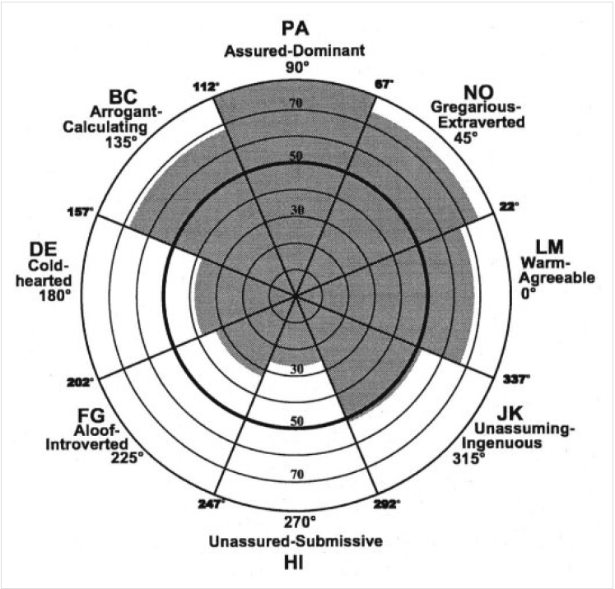
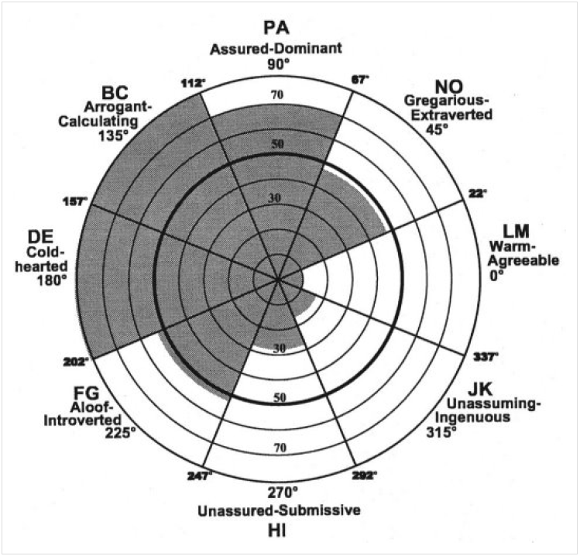
Madeline’s IAS: Self (Left) & Partner (Right)

Slide 40
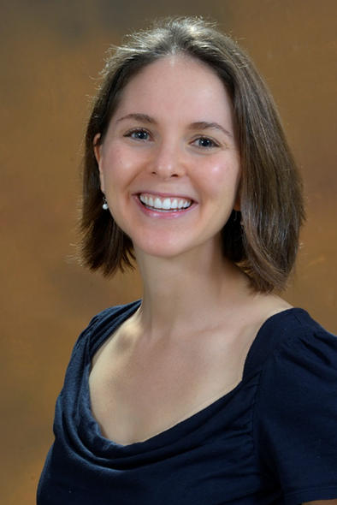
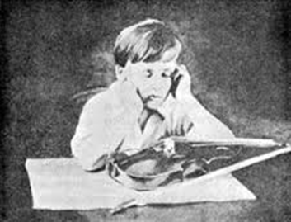
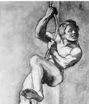
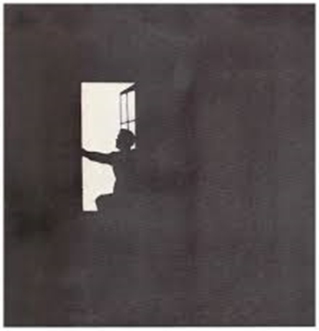
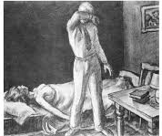
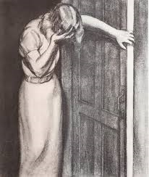
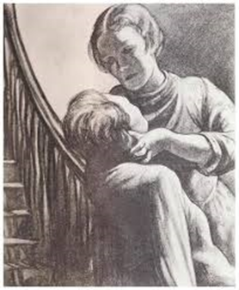
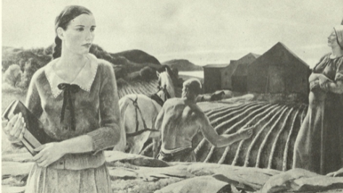
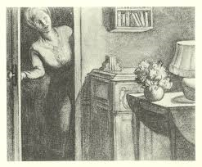
Thematic Apperception Test (TAT)
Coded by: Jenelle Slavin-Mulford, PhD
Social Cognition & Object Relations Scale
SCORS-G (Westen et al., 1985)
8 subscales, 7-point rating
1 2
(pathological)
3 4 5
6 7
(healthiest)
Notes:
The TAT is a performance based task in which participants are asked to generate stories based on pictures they are shown. As part of her assessment, Madeline responded to 9 TAT cards. There is not one gold standard across the field for scoring the TAT, but the SCORS-G has become one of the most commonly used measures. (click for animation) It has 8 subscales which assess different interrelated facets of object relations using a 7 point Likert scale. Here, lower numbers are suggestive of more pathological responses and higher scores are indicative of greater health. For this presentation, Dr. Slavin-Mulford scored Madeline’s TAT responses using the SCORS-G. Dr. Slavin-Mulford has over 10 years of experience with the SCORS-G and is a co-author on the current scoring manual for the measure. Today we will provide Madeline’s average SCORS-G rating for each subscale along with examples and additional qualitative inferences. This will then be used to provide hypotheses regarding Madeline’s object relational world.

Slide 41
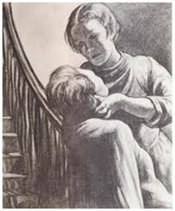
Complexity of Representation of People
Affective Quality of Representations
Emotional Investment in Relationships
Emotional Investment in Values and Moral Standards
Understanding of Social Causality
Experience and Management of Aggressive Impulses
Self-Esteem
Identity and Coherence of Self
Rated 1 (lowest) to 7 (highest)
 | Protocol | COM | AFF | EIR | EIM | SC | AGG | SE | ICS
 | _Waugh________
 | 1 | 2 | 3 | 2 | 2 | 2 | 4 | 4 | 5
 | 2 | 1 | 4 | 5 | 2 | 1 | 4 | 3 | 3
 | 3GF | 3 | 1 | 1 | 2 | 3 | 1 | 3 | 4
 | 14 | 4 | 6 | 2 | 4 | 3 | 4 | 4 | 6
 | 13MF | 3 | 2 | 1 | 2 | 3 | 3 | 4 | 5
 | 5 | 3 | 2 | 1 | 2 | 3 | 4 | 4 | 5
 | 10 | 2 | 5 | 4 | 4 | 2 | 3 | 4 | 5
 | 18GF | 1 | 1 | 1 | 1 | 1 | 1 | 4 | 2
 | 17BM | 2 | 3 | 2 | 2 | 2 | 3 | 4 | 5
mean |  | 2.333333 | 3 | 2.111111 | 2.333333 | 2.222222 | 3 | 3.777778 | 4.444444

Slide 42
Object Relations Inventory (ORI)
Open-ended interview (originally written, A. Sugarman at YPI made it interview, permitting interactional data)
Asks patients to describe
Mother
Father
Significant other
Pet
Self
Therapist

Slide 43
Conceptual Level Scale
Sensorimotor Preoperational (Need gratification or frustration)
Concrete Perceptual (Physical appearance)
External Iconic (Actions or behaviors)
Internal Iconic (Thoughts, feelings, and other mental state) ---Madeline’s scores on ORI---
Conceptual (Coherent, complex integration)
Blatt et al. (1979, 1988)

Slide 44
Differentiation-Relatedness Scale
1 Self-other boundary compromise
2 Self-other boundary confusion
3 Self-other mirroring
4 Self-other idealization or denigration
5 Semi-differentiated tenuous consolidation of representations through splitting (polarization) and/or by an emphasis on concrete part properties.
---Madeline’s score on ORI---
Diamond et al. (1990, 1991, 2014)

Slide 45
ORI: 1. Describe Your Mother
First word pops into mind is witch! She’s greedy.
(describe)…short, roly-poly, two-faced, phony, don’t trust her. But she’s tough, hard-working. I just don’t know her all that well. ‘Cause she won’t let you. Did I say greedy? I’ll say it again—she’s really greedy.
(Witch first thing?) Not good witch or bad witch. Don’t think about her very much. Don't particularly like her; tolerate her—barely. Don’t trust her. Worked hard all her life. Very violent marriage. Three kids really young. As a youngster, I think she had it very hard. Won’t talk about it. Very closed.
(Trust?) She has own set of motives for what she does that are unlike most people’s. I don’t know what she’s really about. Does things if something in it for her, greedy, money hungry, complicated. She won’t let you know her, so your questions remain questions. If you ask her about her childhood, she gets up and leaves! So I’m left with just blanks. Her marriage was brutal. Good cook, though, makes great donuts. Not healthy eater. Very rarely see her. I left very young.
(Young?) When I was 12, in foster homes for a while. They didn’t work out. So I went to work. I couldn’t tell you her favorite color or ice cream, no personal details. Keeps everything to herself.
Auerbach ratings CL= (1-9) 6; D-R (1-10) = 5

Slide 46
Conclusions: Behrends & Blatt -
Action-oriented, mercurial, free-spirit; pushes limits & control moves
Private + exhibitionistic; vulnerable to depression—hypomanic defense
Longing to be valued/needed, underlying sense of emptiness; trauma
Capacity for recovery & creative mastery
Impressionistic cognitive style, but not repressive
Street smart, savvy, rebellious, tries to “beat the system”
Loss of distance on more ambiguous stimuli; polarized thinking
Themes of seduction & betrayal, guilt & innocence
Nagging, unstated question “is something wrong with me?”

Slide 47
General Impressions by Krista Trobst & Jerry Wiggins
She saw the assessment as interesting adventure & potential learning experience
Friends view her as extroverted, exhibitionistic, brash, spirited, opinionated, audacious
“An invitation to one of her infamous parties is considered a social coup,” but “being in public with her can be highly embarrassing for the weak of heart”
Domineering, self-aggrandizing, manipulative, interesting, fun-loving, & engaging
Tells interesting stories and tales, but some embellished & fantastical

Slide 48
Therapeutic Assessment

Slide 49
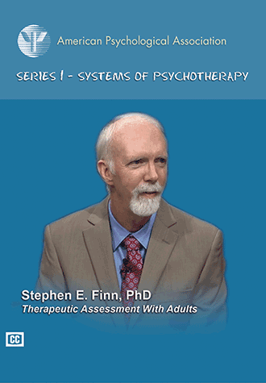
Therapeutic Assessment

Slide 50
Overview of TA
https://youtu.be/JnueYARYiSI

Slide 51
Madeline G.-2.0
Lead Coordinators:
Christopher J. Hopwood & Mark H. Waugh, w/ Krista K. Trobst
Psychodynamic- Gregory J. Meyer, Joni L. Mihura, Mark H. Waugh
Personological (C/TA paradigm)- Stephen E. Finn
Interpersonal- Aaron L. Pincus, Christopher J. Hopwood, Sindes Dawood
Multivariate- Thomas A. Widiger & Christina Crego
Empirical- Yossef S. Ben-Porath

